Slide 1
Table Setting Tables are set for convenience and beauty
Notes:
There are many ways to set the table, depending on the occasion, the style of service, the size of the table and the menu.

Slide 2
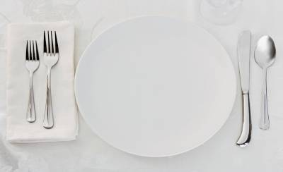
Cover / table setting
The amount of space needed by each person
The cover includes
Linen
Dinnerware
Flatware
Beverageware
Each cover should be at least 24 inches wide.
The guests be able to discern which pieces are theirs by the spacing between covers/table setting.
Notes:
The classifications of table appointments includes the classifications of Dinnerware, Flatware, Beverageware and Holloware. The Cover includes the table linen, the dinnerware, flatware and beverageware.
Holloware are the serving dishes. They are not part of the cover.

Slide 3
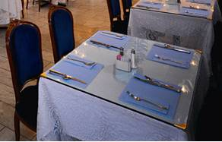
Begin with the Linen
The cloth should extend evenly on each side of the table.
Placemats
flush with the edge of
the table
Or 1 to 1 ½ inches from
the edge
Runners
down the center, or
along both sides
Notes:
Crisply ironed linen or easy care cotton blend fabrics are used for table linens. Less formal occasions may use paper table clothes, placemats and napkins.

Slide 4
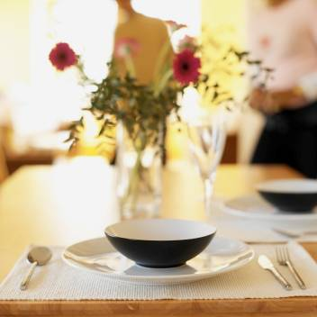
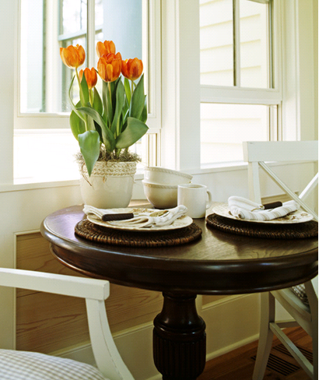
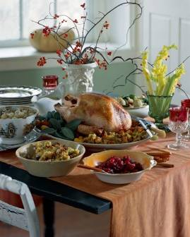
Centerpiece
Notes:
The center piece doesn’t have to always be placed in the center of the table. There could be small arrangements placed diagonally at two corners of the table, or along the back side of a buffet table. The centerpiece is nice but not necessary unless it is a very formal meal.

Slide 5
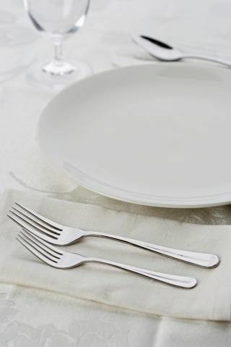
Dinnerware
Plates are placed in the center of each cover
“Thumb length” (1 inch) from the edge of the table
Forks on the left
Knives and spoons on the right
Knife is next to the plate with the blade turned to the plate.
Notes:
What goes on the table depends on the menu and style of service.
The thumb is approximately 1 “ from the first joint to the end of the nail.
Flatware is placed in the order in which it is used.
To remember the fork goes on the left, count the letter in fork = 4. The word “Left” also has four letters, so fork and left go together.. Knife and spoon each have 5 letters, the word “right” also has 5 letters, so the knife and spoon go to the right of the plate.

Slide 6
Informal and one-dish meals
Use ONLY the dinnerware and flatware that are needed for the meal.

Slide 7
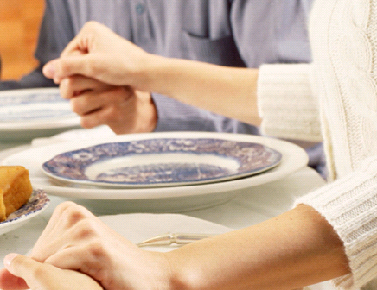
Service Plate
Larger than dinner plate
First courses are placed on the service plate by the service person.
The service plate is removed when the main entrée is served.
Notes:
A service plate is used for more formal meals. The appetizers, soup, salad, and other first courses are served on the service plate. The waiter removes the service plate just before placing the dinner plate for the main course.
Other dishes are added to the cover, depending on the menu and the formality of the meal.

Slide 8
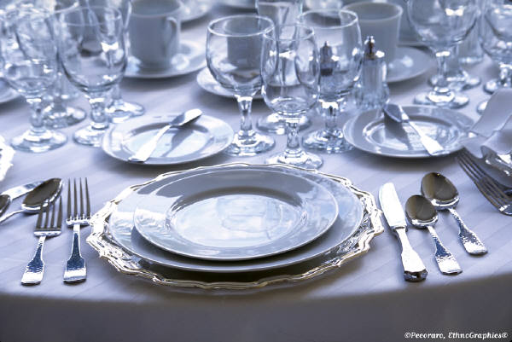
Place the flatware in the order in which it will be used
Used with permission
Notes:
If a salad will be served before the main course, the small fork is left of the large fork. If the salad is served with the main course, a salad fork is not necessary. If the small fork is intended for a dessert, it will be between the dinner plate and the large fork. If there is a large spoon at the far right, it is intended for a soup course. There is a spoon for stirring coffee, and another small spoon may be provided for a dessert. The spoons are always to the right of the knife – even the dessert spoon.

Slide 9
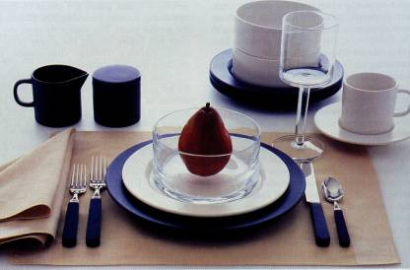
Beverageware
Used with permission
Place the water glass at the tip of the knife.
A cup and saucer are placed beside the knife and spoon.

Slide 10
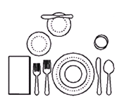
At More Formal Meals
Place the salad plate to the left of the dinner plate.
Place the bread and butter plate just above the salad plate, between the salad and dinner plates.

Slide 11
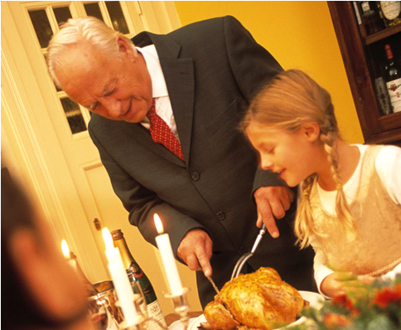
Service Pieces
Place the serving utensil on the table at the right side of a dish to be passed.
If there are two serving utensils, place the “helper” utensil on the left and the main utensil on the right.

Slide 12
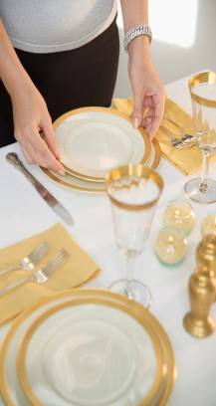
Details
Place the salt to the right of the pepper when placing it on the table.
Place the napkin beside the forks if there is enough space, otherwise put the forks on top of the napkin.
The loose corner of the napkin should be beside the plate.

Slide 13
Classifications of Table Appointments
Dinnerware
Flatware
Beverageware
Holloware

