Slide 1
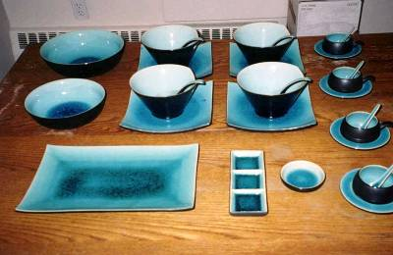
Table Appointments
All the items needed at the table to serve and eat a meal.

Slide 2
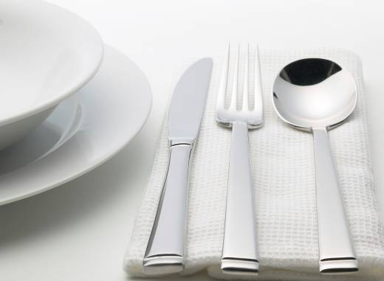
Classification of Tableware
Dinnerware
Flatware
Beverageware
Holloware

Slide 3
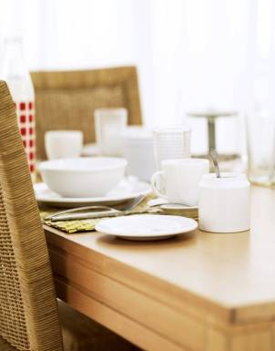
Dinnerware is:
Plates, cups, saucers, bowls
Dinnerware includes:
China
  stoneware
  earthenware
  pottery
Other materials
  glass-ceramic
  plastic
Notes:
When selecting dinnerware consider how the color and design will look with food. China is translucent – hold a plate up to the light with your hand behind it. You should be able to see the outline of your hand through the plate. Some stoneware is more costly than fine china, and it chips more easily than does china.

Slide 4
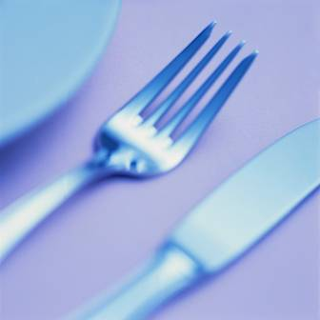
Flatware is:
Often called “silverware” and includes:
  Knives
  Forks
  Spoons
  Specialty utensils
Materials made from:
  Sterling
  Silver plate
  Stainless
  Plastic /wood

Slide 5
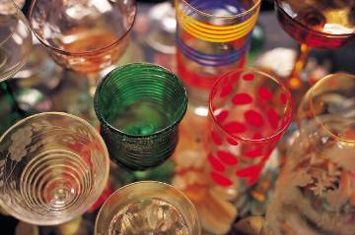
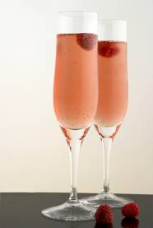
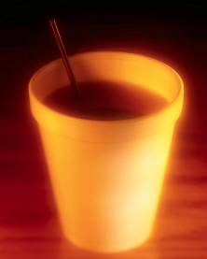
Beverageware or glassware is:
Lead glass
  Higher quality
  More expensive
Lime glass
  Lighter, more brittle
  Ideal for much glassware
Plastic
  Very casual, low cost
  Unbreakable / disposable
Notes:
Beverage ware adds beauty and height to the table setting. Consider how the beverage ware will look with your dinnerware and flatware. High quality lead glass is referred to as Crystal, because of it’s exceptional clarity and brilliance.

Slide 6
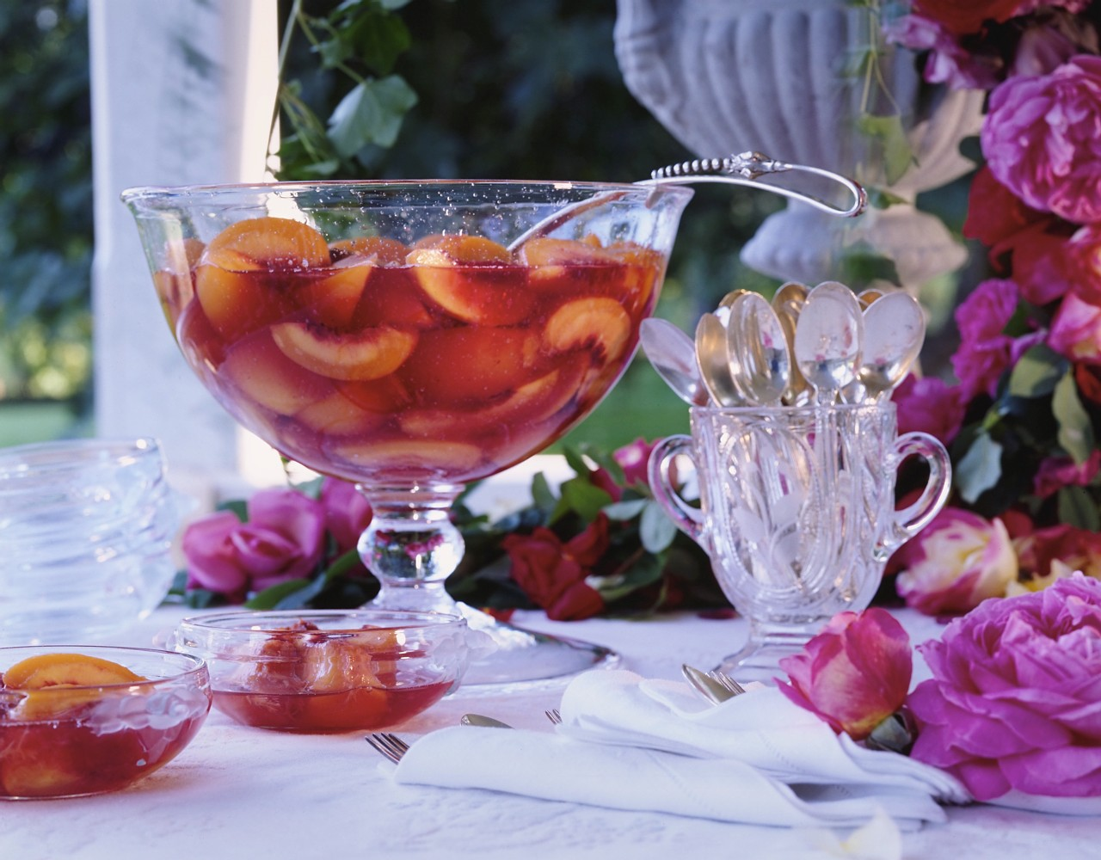
Lead Crystal Punchbowl
Notes:
When purchasing lead glass, brilliance is an indication of quality. When the glass is tapped it should produce a lingering bell-like ring. Lead crystal is often “cut” to create facets that sparkle, or etched to apply a dainty design on the glass.

Slide 7
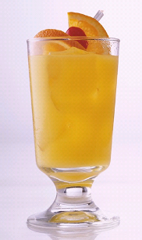
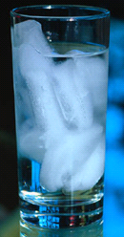
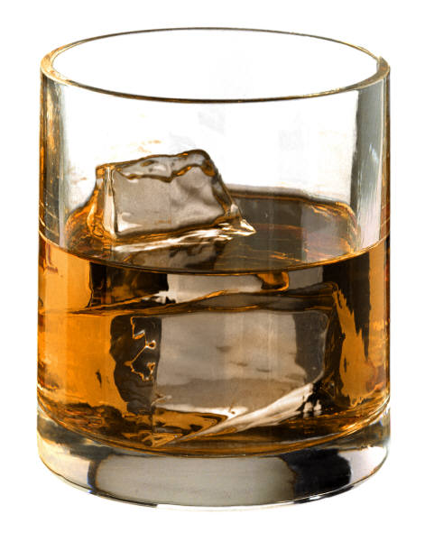
Two basic shapes of beverageware are:
Stemware
Tumbler
Popular sizes are
Cooler
Highball
Juice
bowl
stem
foot
Popular sizes include
Water goblets
Sherbets
Flutes

Slide 8
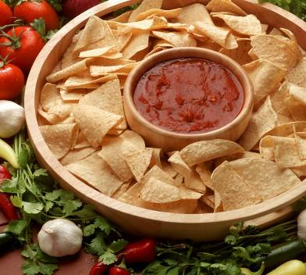

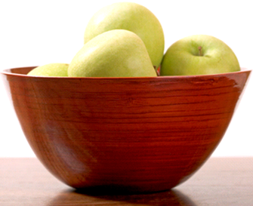
Holloware
Bowls and tureens used to serve food

Slide 9
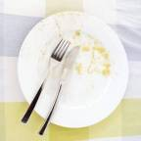
Care of tableware
Rinse tableware as soon as possible after use
Most dinnerware is dishwasher safe
Delicate china and stemware
  May need hand washing
  Don’t plunge into hot water because severe temperature change can crack or break delicate tableware
  More expensive tableware requires extra care to protect your investment.

Slide 10
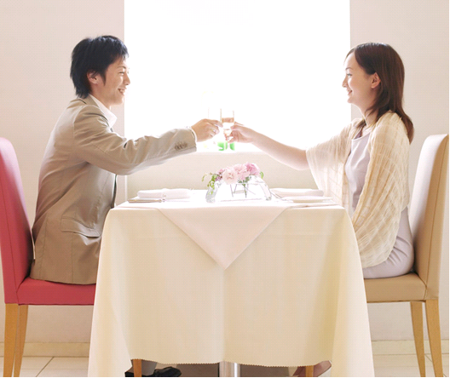
Table linens
Protect the table surface
Deaden sounds of serving and clearing
Add beauty to table setting
Drop – the part that hangs over the edge
For casual should be 6-8 inches on all sides
Deeper drop for a formal setting
Even more for buffet settings
Notes:
White or pastel colored table linens complement formal settings. What you select should be durable, and easy to care for. Some table linens shrink when washed, so check for colorfastness and shrinkage before buying. Linen must be carefully laundered and ironed while still damp.
Paper napkins, placements and tablecloths are inexpensive and save clean up time, but are appropriate only for casual dining.
Vinyl-coated tablecloths and placements are also casual, but durable.

Slide 11
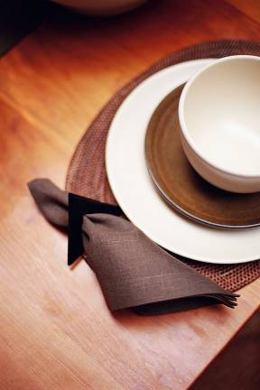
Cloth Placemats, Table Runners & Napkins
Runner: 13-17 inches wide
  placed down the table center
  Often used with placemats
Placemats
  approximately 11 x 17 inches
Napkins
  cocktail - 10 inches
  luncheon – 13 inches
  dinner – 17 or more inches
Notes:
If your tabletop is attractive, placemats are useful in all but the most formal settings
Napkins can match or contrast with table linens. Solid colored table linens should be used if the dishes are patterned. Rough textures and bright colored table linens are more casual.

Slide 12
Center Pieces
Be creative
  Food and the soil of potted plants don’t mix.
Candles are appropriate for evening, but not daytime meals
Candles on the table should be lit and the flame above eye level.
Size in proportion to the table
Guests should be able to see over the centerpiece

