Slide 1
Cutting, Preparation, and Cooking Terms

Slide 2
Cutting Terms

Slide 3

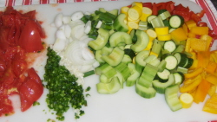
Chop
To cut food into small, uneven pieces
Equipment: French or Chef’s Knife

Slide 4

Mince
To cut food into very fine, uneven
pieces.
Equipment: French or Chef’s knife.

Slide 5
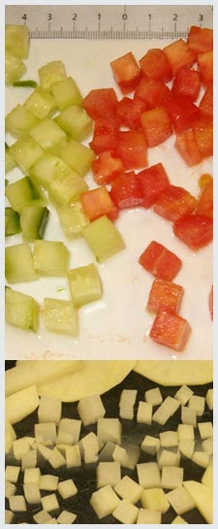
Cube
To cut food into small, equal size squares about ½ inch in size.

Slide 6
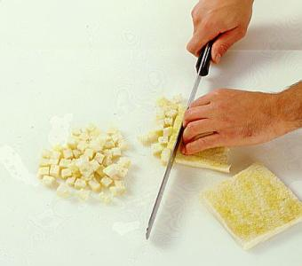
Dice
To cut food into small, equal size squares about ¼ to 1/8 inch in size.
Equipment: French or Chef’s Knife, c. board

Slide 7
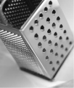
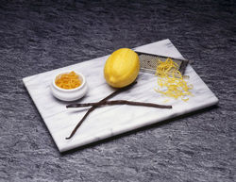
Grate
To reduce food into small pieces by pressing and rubbing it against the “teeth” of a grater.
Equipment: Grater

Slide 8
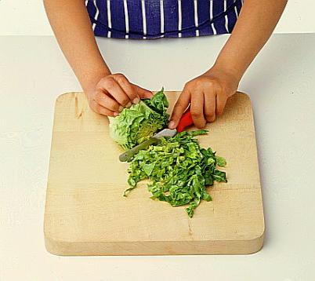
Shred
To cut or break food into long, thin strips by using a knife, fork, or grater.

Slide 9
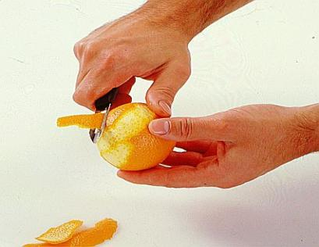
Pare
To remove the stem and the very thin layer of peel of a fruit or vegetable with a paring knife or peeler.

Slide 10
Peel
To remove the outer layer/skin, by stripping or pulling off with your finger or a knife

Slide 11
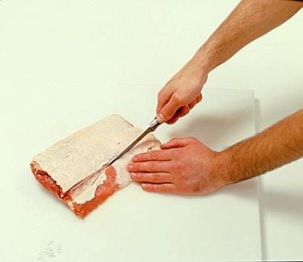
Score
To make small, straight, shallow cuts with a slicing knife in the surface of a food; often done to tenderize meat or to let sauces soak in.

Slide 12
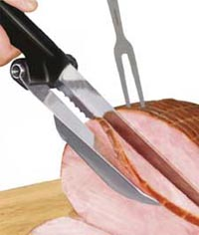
Slice
To cut food into large, thick or thin flat pieces with a slicing knife. Use a sawing motion while gently pressing the knife down.

Slide 13
Preparation Terms

Slide 14

Baste
To pour or spoon pan juices, melted fat, or sauces over the surface of a food during cooking, using a baster, cup, or spoon, to keep the food moist and add flavor.

Slide 15
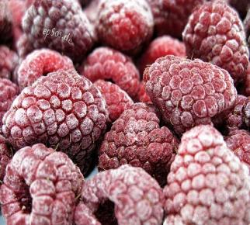
Freeze
To lower a food’s temperature to freezing or below by placing it in a freezer.

Slide 16

Defrost/Thaw
To expose to warmth in order to free from a frozen state.

Slide 17
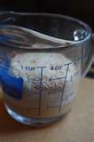
Dissolve
To cause a solid food to turn into or become part of a liquid.

Slide 18
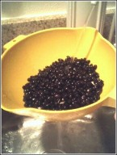
Drain
To remove liquid from a solid food by pouring off the liquid, putting the food through a colander, or drying with paper towels.

Slide 19
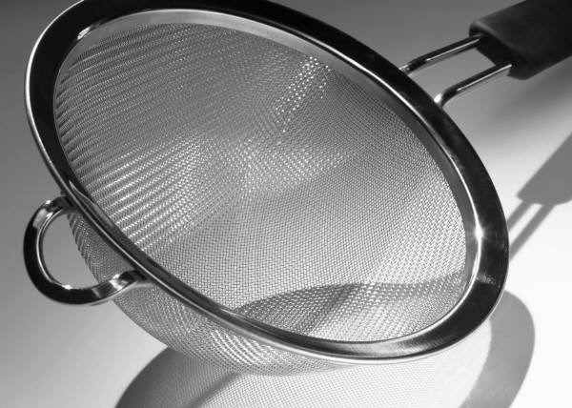
Strain
To separate solid from liquid materials by pouring the mixture through a strainer or sieve.

Slide 20
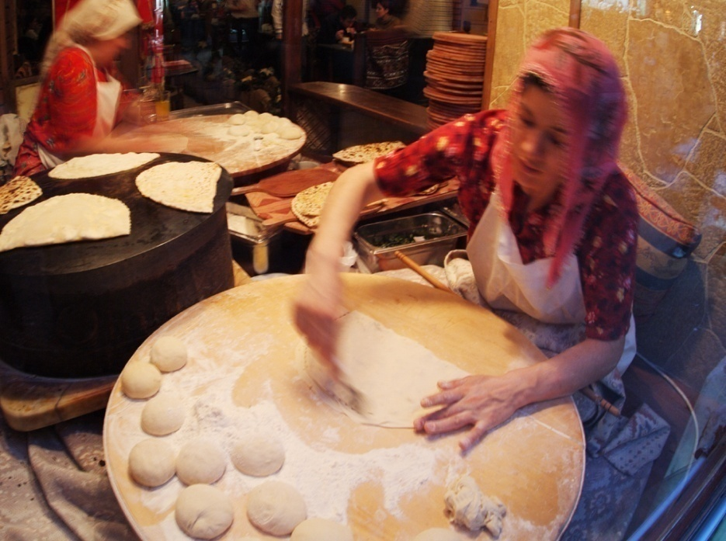
Dust
To lightly sprinkle the surface of a food with crumbs, flour, or sugar.

Slide 21
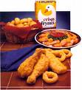
Flour/Dredge/Coat
To sprinkle or coat a food with flour.
Equipment: Flour, crumbs or seasoning.

Slide 22
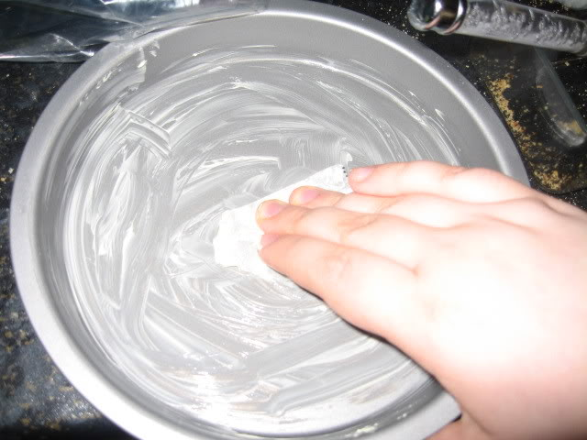
Grease
To rub fat on the surface of a food or a cooking utensil

Slide 23
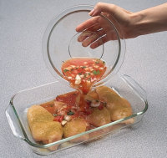
Marinate
To soak food in a cold, seasoned liquid, usually containing an acid, in order to add flavor to or tenderize the food.

Slide 24
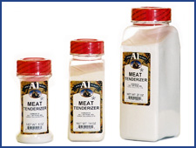
Tenderize
To make something easy to chew by applying a process or a substance that breaks down connective tissue or fiber.

Slide 25
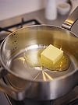
Melt
To change food from a solid to a liquid by applying heat.

Slide 26
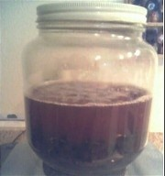
Soak
To immerse food in a liquid for the purpose of wetting, softening, dissolving, or cleaning.

Slide 27
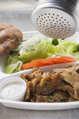
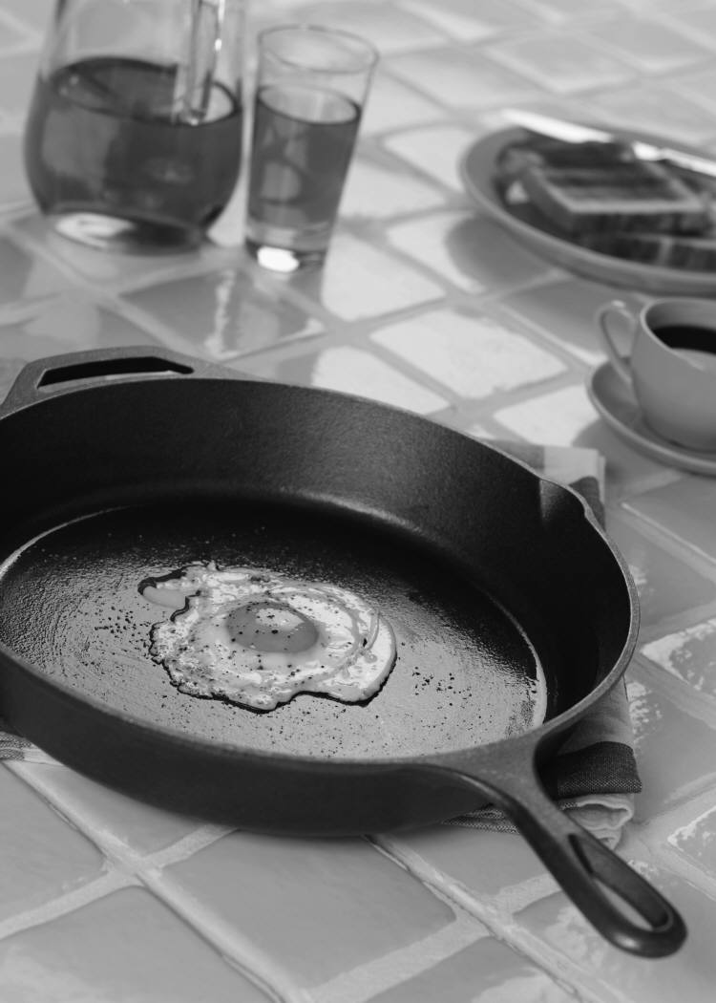
Season
To increase the flavor of a food by adding herbs, spices, or other ingredients; to prepare a cooking utensil for cooking. (Ex. Cast iron skillet)

Slide 28
Vent
To leave an opening in the covering of a food through which steam can escape.

Slide 29
Mixing Terms

Slide 30
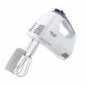

Beat
To thoroughly mix ingredients and incorporate air using a spoon, wire whisk, mixer, or food processor with an up-and-down and circular motion

Slide 31
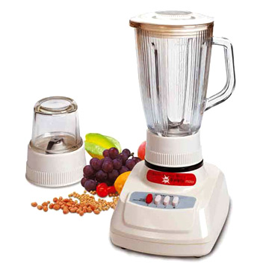
Blend
To stir or mix ingredients until they are thoroughly combined and smooth

Slide 32
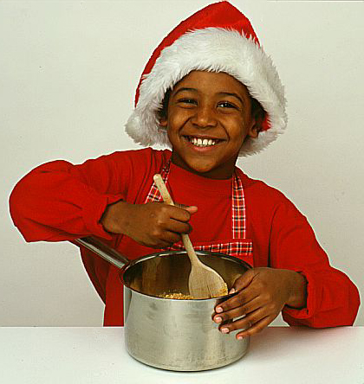
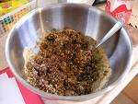
Combine
To blend or mix two or more ingredients

Slide 33
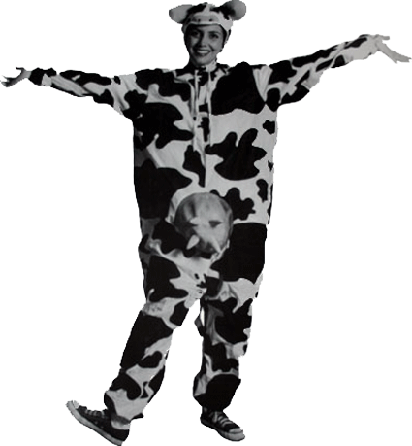
Cream
To beat solid fat and sugar with a wooden spoon or electric mixer until smooth, light, and creamy

Slide 34
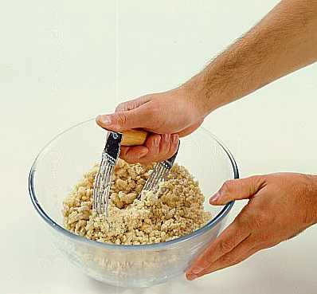
Cut in
To combine flour and solid fat by cutting the fat into tiny pieces using a pastry blender, two forks or knives, or the hands

Slide 35

Fold in
To blend a delicate mixture into a heavier one, using a rubber spatula, spoon, or wire whisk in a gentle up, down, and over motion so that the mixture stays light
Equipment: Bowl and spatula

Slide 36

Knead
To work a ball of dough with the heels of the hands repeating press, fold, and turn motions until the dough is smooth and elastic
Equipment: Hands

Slide 37
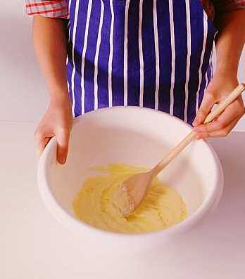
Mix
To combine two or more ingredients into one mass by stirring or beating them

Slide 38
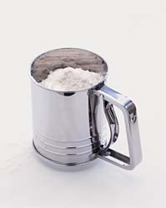
Sift
To reduce dry ingredients to finer particles, add air to dry ingredients, or combine dry ingredients by putting them through a sieve

Slide 39
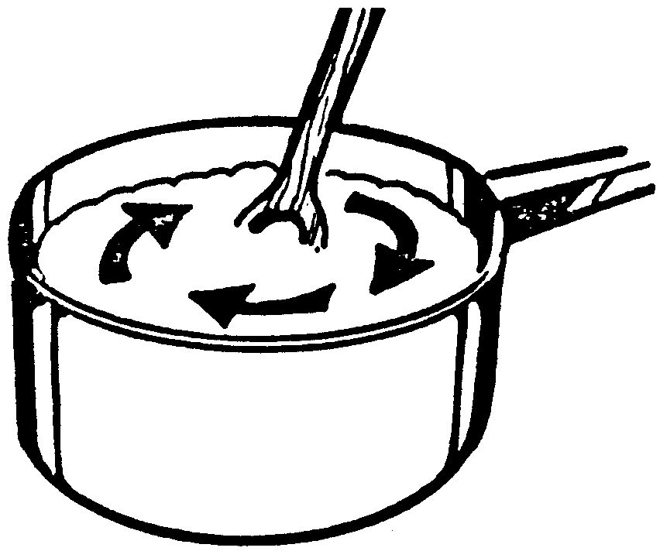
Stir
To mix using a spoon or wire whisk with a circular motion

Slide 40

Toss
To lightly mix ingredients by tumbling them with tongs or a large fork and spoon

Slide 41
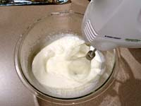
Whip
To beat quickly and vigorously by hand, wire whisk, or mixer to incorporate air and to make a mixture light and fluffy
Equipment: Wire whisk or electric mixer

Slide 42
Cooking Terms:
Dry Heat Methods

Slide 43
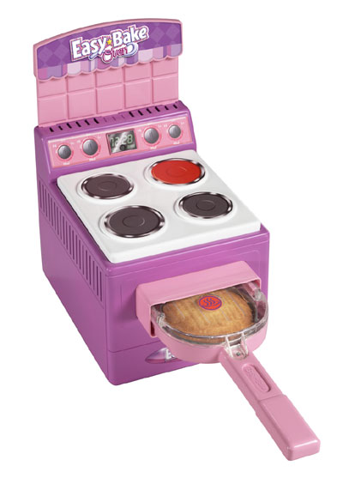
Bake
To cook in an oven with dry, hot air

Slide 44
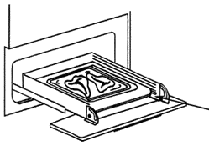
Broil
To cook uncovered under a direct heat source

Slide 45
Grill
To broil over hot coals or on a griddle

Slide 46
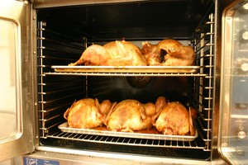
Roast
To cook meat, fish, or poultry uncovered in an oven with dry, hot air

Slide 47
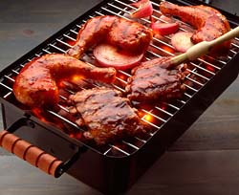
Barbeque
To roast slowly on a rack or spit over hot coals or some other direct heat source and baste with a spicy sauce

Slide 48
Cooking Terms:
Moist Heat Methods

Slide 49
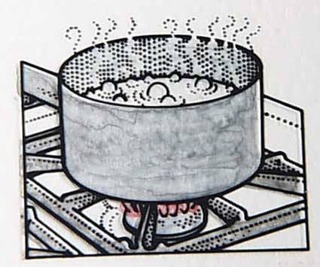
Boil
To cook food in hot liquid, 212⁰F, having bubbles that rise to and break on the surface of the liquid

Slide 50
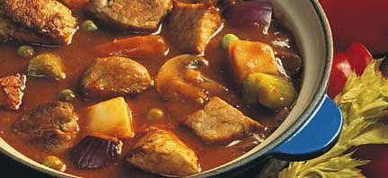
Braise
To cook large pieces of meat or poultry slowly over low heat in a small amount of hot liquid in a tightly covered pan

Slide 51
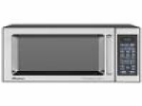
Microwave
To cook food in a microwave oven using little or no liquid

Slide 52
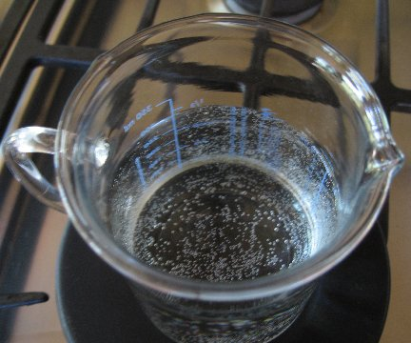
Simmer
To cook food in liquid that is just below the boiling point
Equipment: Saucepan

Slide 53
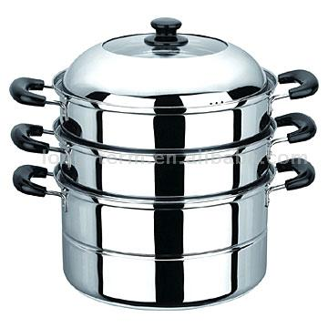
Steam
To cook food in a pan using vapor produced by a boiling liquid
Equipment: Steamer or Double Boiler

Slide 54
Cooking Terms:
Cooking in Fat Methods

Slide 55
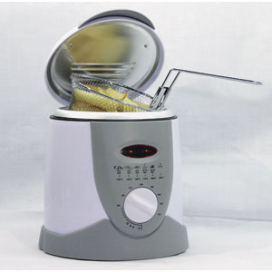
Deep-fry
To cook food by completely immersing in hot fat; also know as French fry

Slide 56
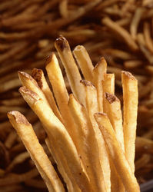
Fry
To cook food in a small amount of hot fat

Slide 57
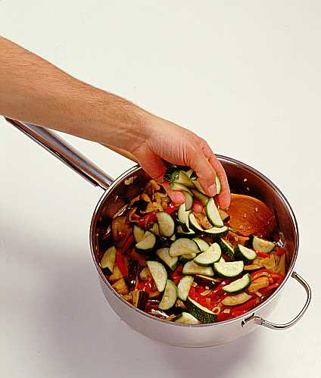
Sauté
To lightly brown or cook food in a small amount of hot fat over moderate heat; Pieces of food are cut into small or thin pieces preserving texture, moisture, flavor.
Equipment: Frying pan and butter/oil

Slide 58
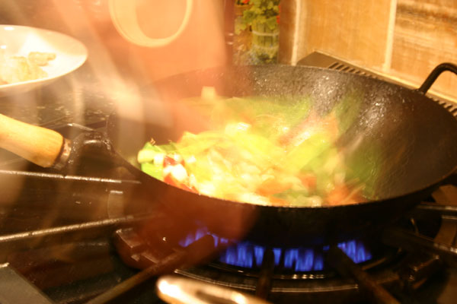
Stir-fry
To cook bite-sized small pieces of food quickly over high heat in a small amount of fat while stirring constantly.

Slide 59
Miscellaneous

Slide 60
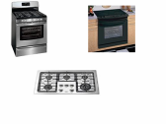
Preheat
To turn on an appliance or oven to a desired temperature about 5-10 minutes before food is to be placed in it

