Slide 1
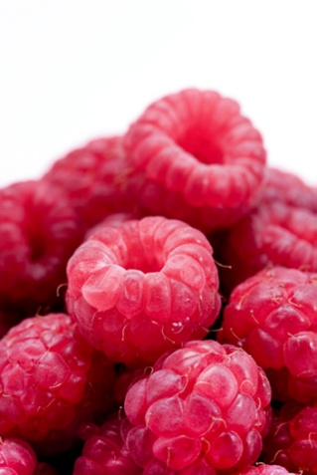
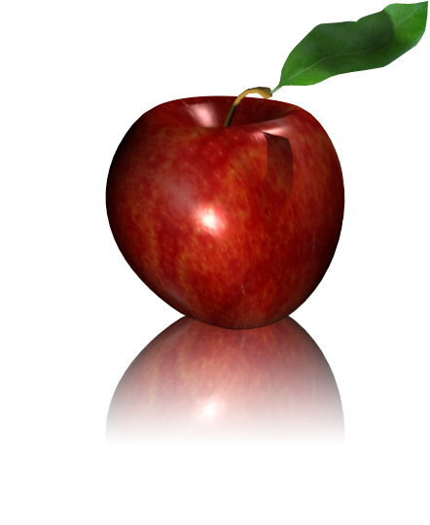

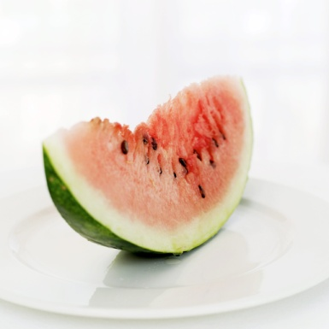


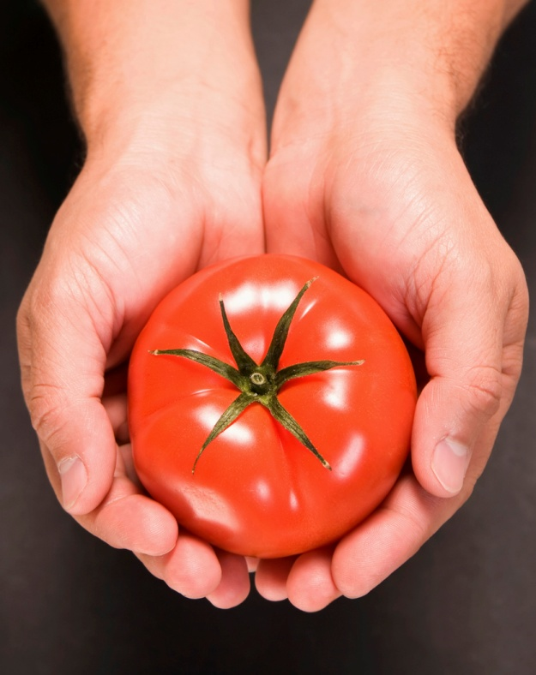
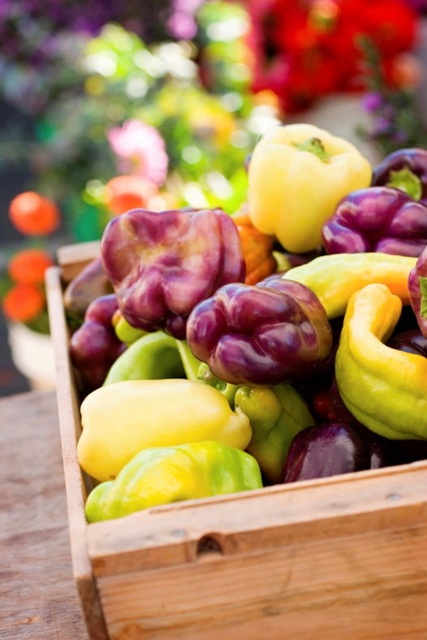
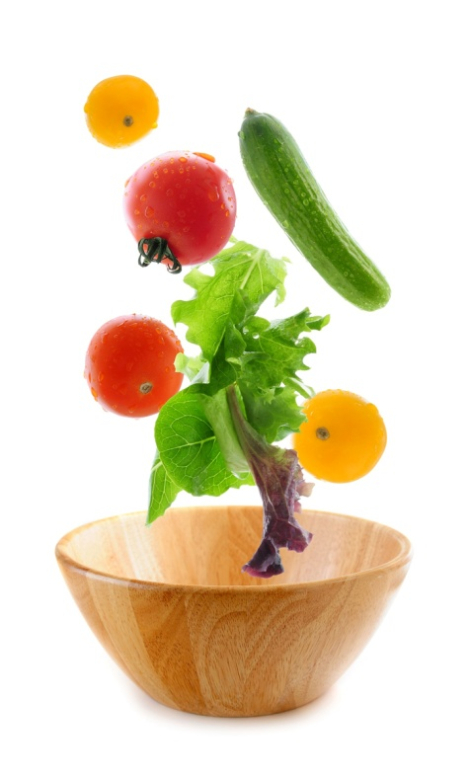
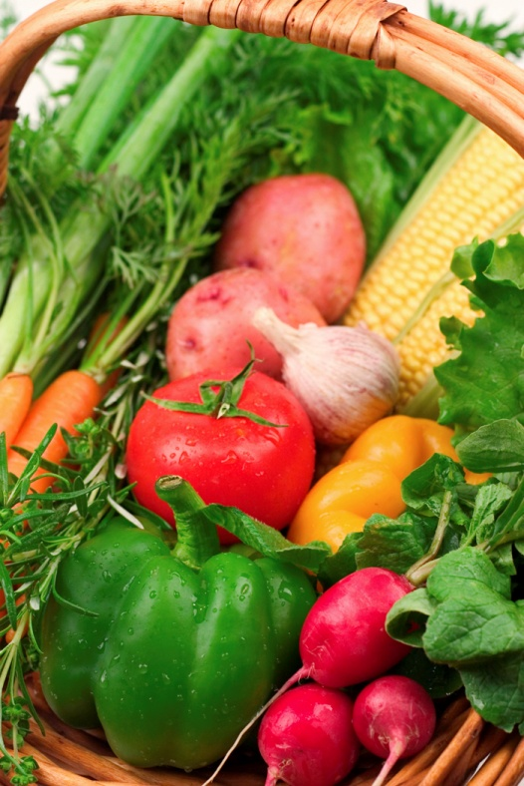
ALL ABOUT
FRUITS & VEGETABLES

Slide 2
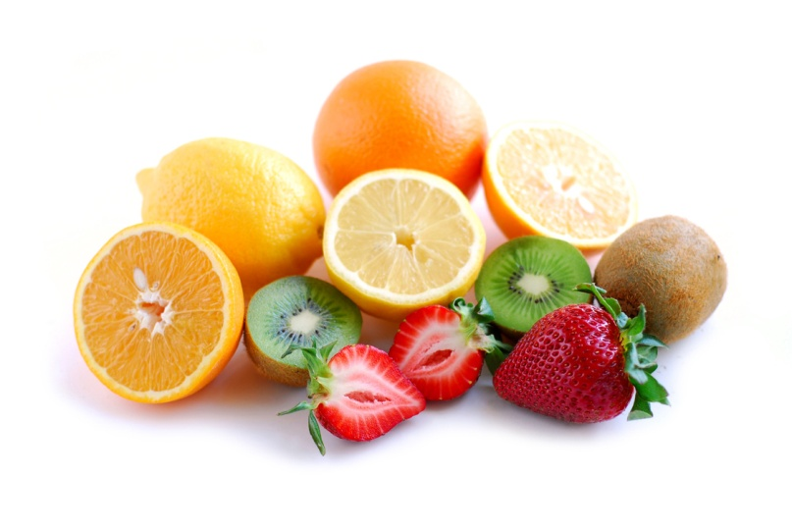
Why should we eat FRUIT?
Fruits are high in:
Vitamins A & C
Fiber
Carbohydrates
Potassium
Fruits are low in:
Fat
Calories
Sodium
Some fruits also contain folic acid,
magnesium, iron, etc.

Slide 3
SIX Categories of Fruits
BERRIES: strawberries, raspberries, cranberries, grapes
MELONS: watermelon, cantaloupe, casaba
CITRUS FRUITS: oranges, lemons, limes
DRUPES: cherries, apricots, peaches, plums
POMES: apples, pears
TROPICAL FRUITS: bananas, mangos, pineapples

Slide 4
How can we purchase fruits?
Some fruits are available all year, others are SEASONAL!
CANNED
Convenient and easy to store
Heavier syrup = higher calories
FRESH
Nutritious & delicious
Short shelf life
FROZEN
Just as nutritious as fresh
Texture can change
DRIED
Nutritious
Have a high concentration of natural sugar

Slide 5
What should we look for when selecting fruits?
GOOD (ripe & mature fruit) | BAD (fruit is not ripe or mature)
Tender; gives when pressed | hard
Full size | Small size
Full color | “green” fruit
Heavy | Light for its size
Pleasant aroma, tasty! | No smell present; not good to eat!

Slide 6
Fruit can be eaten…
Fresh
Cooked in liquid
Baked
Broiled or Grilled
Fried
Microwaved

Slide 7
Preparing FRESH Fruit
ALWAYS wash fruit in cool water before cooking/eating to remove dirt and pesticide residue!
    Even if you aren’t eating the skin (ex. watermelon)
When peeling or paring fresh fruit, peel as THINLY as possible to preserve nutrients found just under the skin.
Fresh fruits are easier to eat when cut in pieces, but serve them as soon as possible to retain nutrients

Slide 8
What happens to fruits & vegetables during COOKING?
NUTRIENTS- loss of heat-sensitive nutrients like Vitamin C
COLOR- some become lighter, some become deeper
FLAVOR- more mellow, less acidic
TEXTURE/SHAPE- when heat is applied, the fruit’s cells lose water and soften, can cause the fruit to fall apart; cook only until fork tender

Slide 9
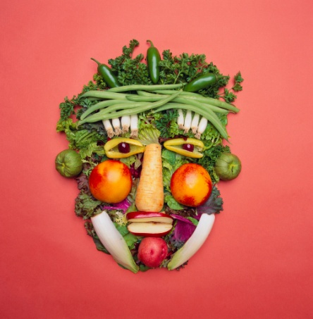
Vegetables are grouped according to the part of the plant from which they come.
FLOWERS: artichokes, broccoli, cauliflower
FRUITS: tomatoes, cucumbers, eggplant, okra, peppers, pumpkins, squash
STEMS: celery, asparagus
LEAVES: brussels sprouts, cabbage, lettuce, spinach
SEEDS: Peas, corn, beans
ROOTS: beets, carrots, parsnips, radishes, sweet potatoes, turnips

Slide 10
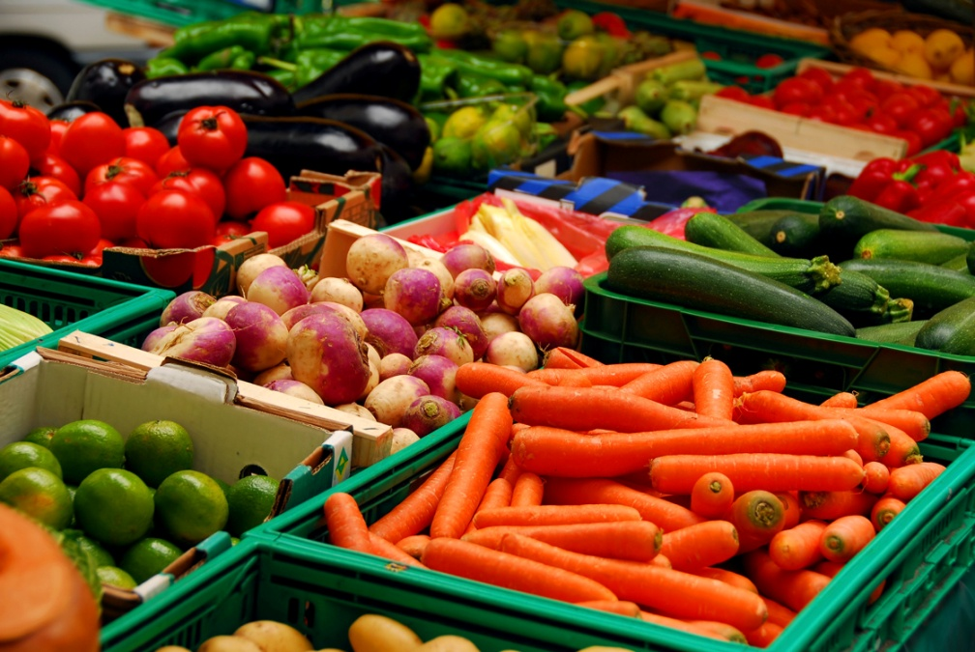
What nutrients are in vegetables?
Leafy green and deep yellow veggies are excellent sources of Vitamin A
Broccoli, green peppers, and raw cabbage are high in Vitamin C
Veggies have ANTIOXIDANTS!
  Lower the risk of some cancers and heart disease
Veggies are high in FIBER!
  Especially the skin!

Slide 11
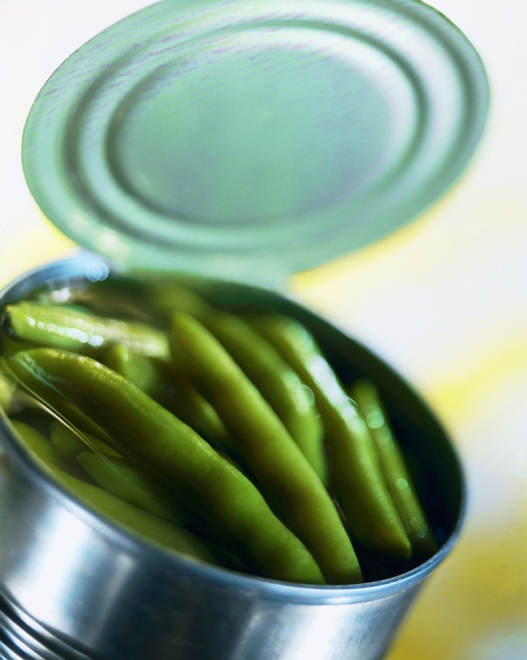
Helpful Tips for Cooking Veggies
Cook vegetables until they are CRISP-TENDER!
Bake potatoes between 300 and 450°.
Remember that cooked vegetables lose Vitamin C and other nutrients.
Don’t overcook, veggies
will develop unpleasant flavors!
If cooking canned vegetables,
drain the water first to lower
sodium levels.

Slide 12

Good Ways to Prepare Veggies:
SERVE FRESH!
Microwaving: helps retain most of the nutrients, keeps color, texture, and shape while using little water
Steaming: takes a little longer than microwaving, but also retains more nutrients than ANY of the other methods!
Other options: ROASTING, GRILLING, SIMMERING, DEEP-FRYING, SAUTEEING, etc.

